Slide 1





Hybrid(Transformer+CNN)-based Polyp Segmentation
Madan Baduwal
Paper
Code
Data

Slide 2
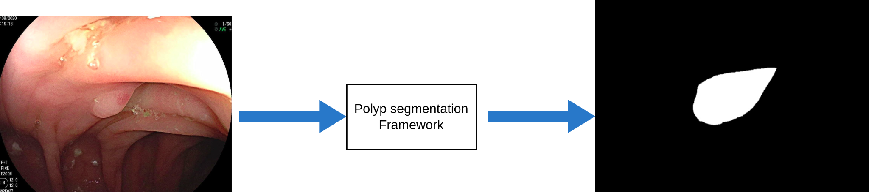
POLYP SEGMENTATION | INTRODUCTION

Slide 3
POLYP SEGMENTATION | CHALLENGES AND SOLUTIONS
CHALLENGES
SOLUTIONS
1
Low Contrast and Subtle Visual Cues
1
Hybrid Models with Deep Learning and Medical Knowledge
2
High Variability in Anatomy and Pathology
2
AutoML and Hyperparameter Tuning
3
Small, Specific target Areas
3
Active learning to Expand Dataset
4
Class Imbalance
4
Use of Hybrid(Transformer-CNN) Models(ours)
5
Lack of Large, Annotated Dataset
6
Occlusions and artifacts

Slide 4
POLYP SEGMENTATION | DATA PREPROCESSING
1
Image resizing: 352 x 352 pixels
2
Normalization: range [0, 1] for better model convergence
3
Mask Encoding: Convert masks to binary or categorical format
4
Data Augmentation: flipping, rotation, zoom, and brightness adjustments
5
Splitting Dataset: train: 80%, test: 20%
6
Data generator: Efficiently feed data to the model

Slide 5
POLYP SEGMENTATION | IMPLEMENTATION SETUP
1
1
Epochs:50
Framework: Implemented in PyTorch, trained on an NVIDIA GeForce RTX 4090 GPU with 24GB VRAM.
2
2
Batch:8
Training Strategy: Used multi-scale input handling, AdamW optimizer and a BCE+IoU loss function.
3
3
Imgsz:352*352
Setup: Images resized to 352×352 pixels, mini-batch size of 8, trained over 50 epochs (optimal at epoch 37).
4
Workers:8
4
Early Stopping: Stopped training if no accuracy improvement after 37 epochs (ended at epoch 50).
5
5
Optimizer:AdaW
Data Augmentation: Applied random rotation and flipping during training.
6
6
Dropout: 10
Testing: Resized inputs with no post-processing, ensuring efficiency and robust results.
7
Evaluation and Interpretability
7
Recall: 0.9849

Slide 6
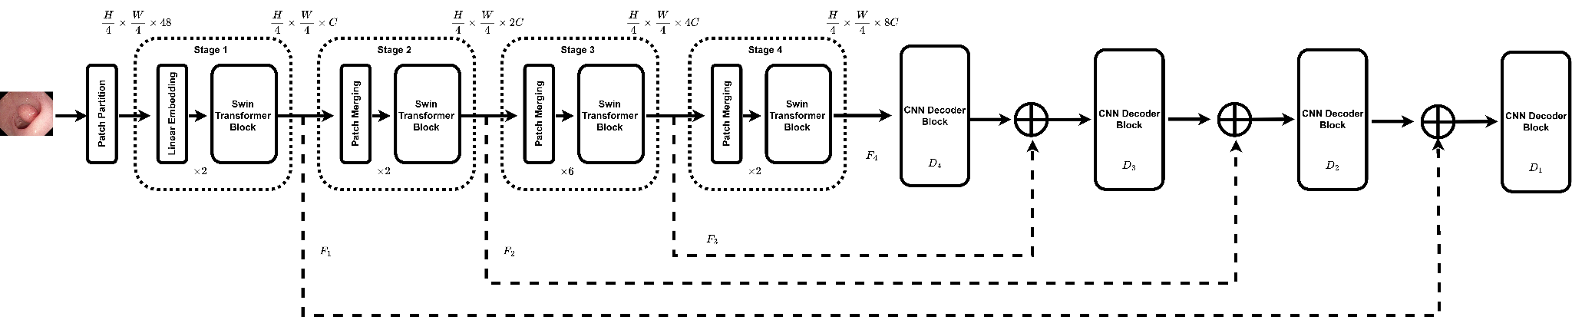
POLYP SEGMENTATION | ARCHITECTURE

Slide 7
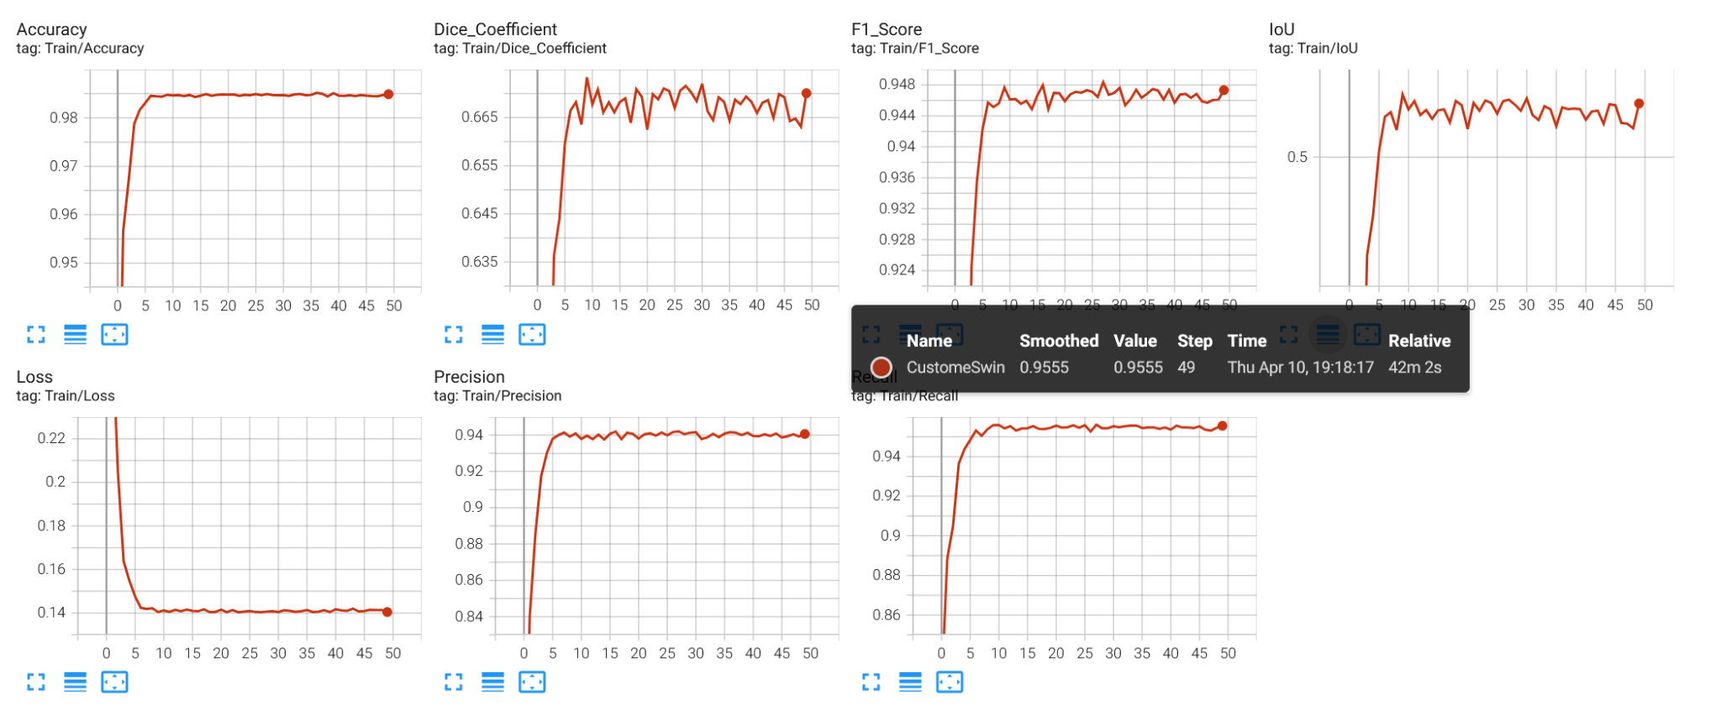
POLYP SEGMENTATION | RESULTS

Slide 8
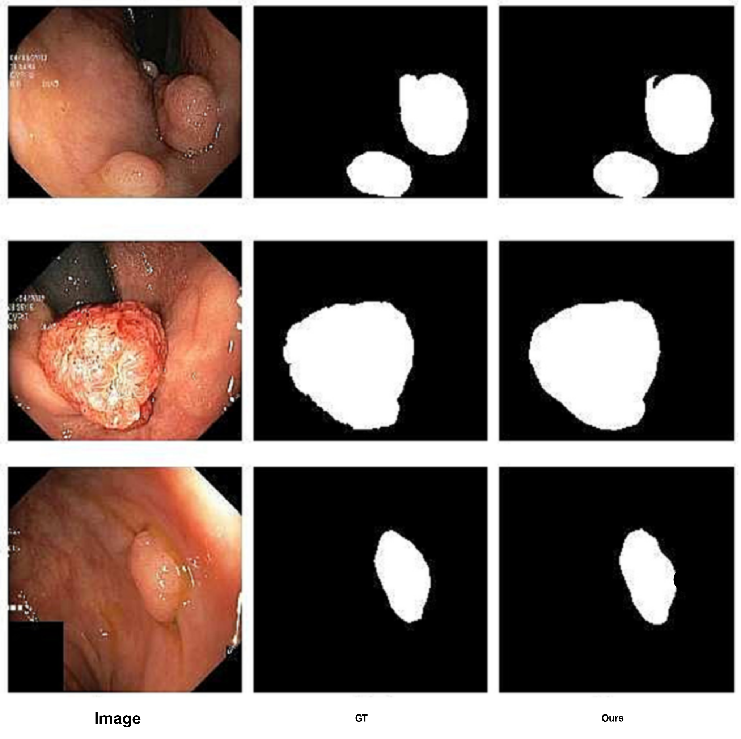
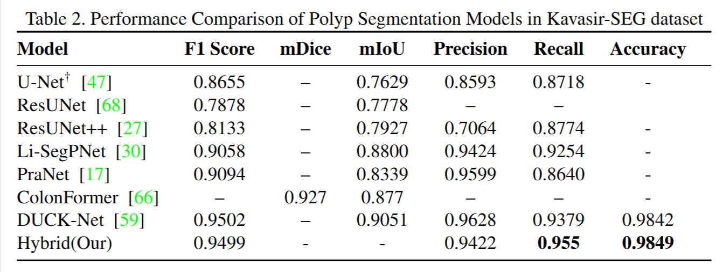
POLYP SEGMENTATION | RESULTS

Slide 9
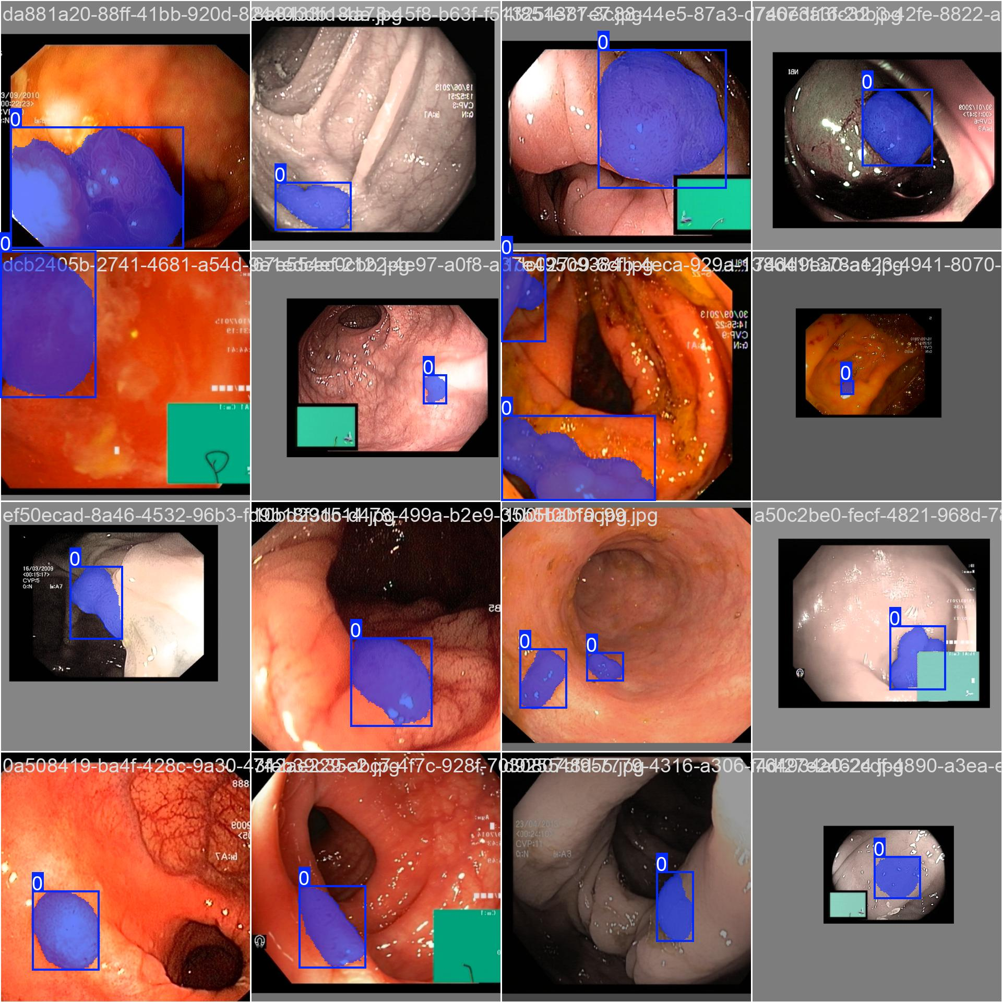
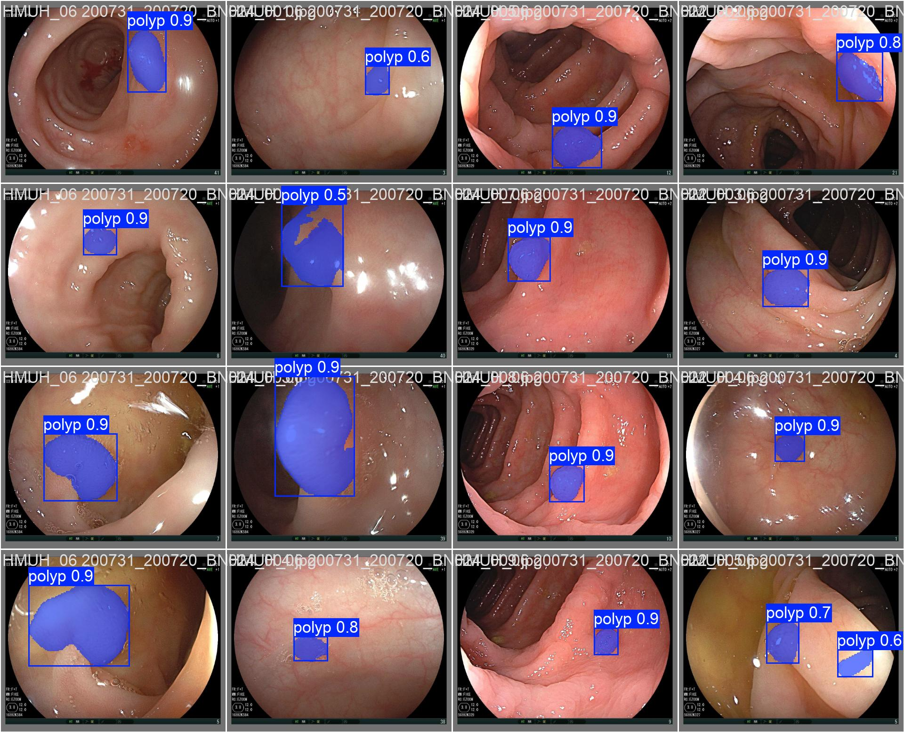
POLYP SEGMENTATION | PREDICTION OUTPUT

Slide 10
POLYP SEGMENTATION | CONCLUSION
1
Introduced a Hybrid(Transformer + CNN), a real time polyp segmentation method
2
Utilized swin vision transformer backbone for efficient feature extraction
3
Achieved top performance metrics: Accuracy and Recall
4
Enable applications in colonoscopy for detecting challenging polyps
5
Enable applications in colonoscopy for ensuring completeness of polyp resection
6
Potential applications in medical fields like diabetic foot care(early detection of neuropathy and ulcer susceptibility)
7
Potential applications in medical fields like ot cartilage quality assessment during surgeries like arthroscopy or knee arthroplasty

Slide 11
THANK YOU

